Slide 1
Amazon Assignment

Slide 2
TO CREATE THE BACKEND APIS FOR PRODUCT SEARCH, USER REGISTRATION, FILTER, REVIEWS, AVAILABILITY SELLER INFO, ETC.

Slide 3



TECHSTACK
IDE: Intellij IDEA
Database: PostgreSQL
Programming Language: Java
Framework: Spring Boot

Slide 4
OBJECTIVE
User can register to purchase an item .(Book)
Click on the search bar and search products (coding books) on amazon search.
They list out all coding related books as your search.

Slide 5
FEATURES
Search a book on amazon (coding books)
List Out all the coding related book
Click which book you buy or view.
Click to select book from listing.
Showing the book’s short introduction.
Book price.
Showing page length, Language, publisher,publication date.
Showing product status (in stock or out of stock)
Add to cart and sold by.
Customer rating

Slide 6
FEATURES
Book Genres
Example: coding, sport, lifestyle, etc.
Customer reviews
Based on purchase ratings
Languages:
List of languages.
Author of the book
Product seller.
List of seller
Availability of book

Slide 7
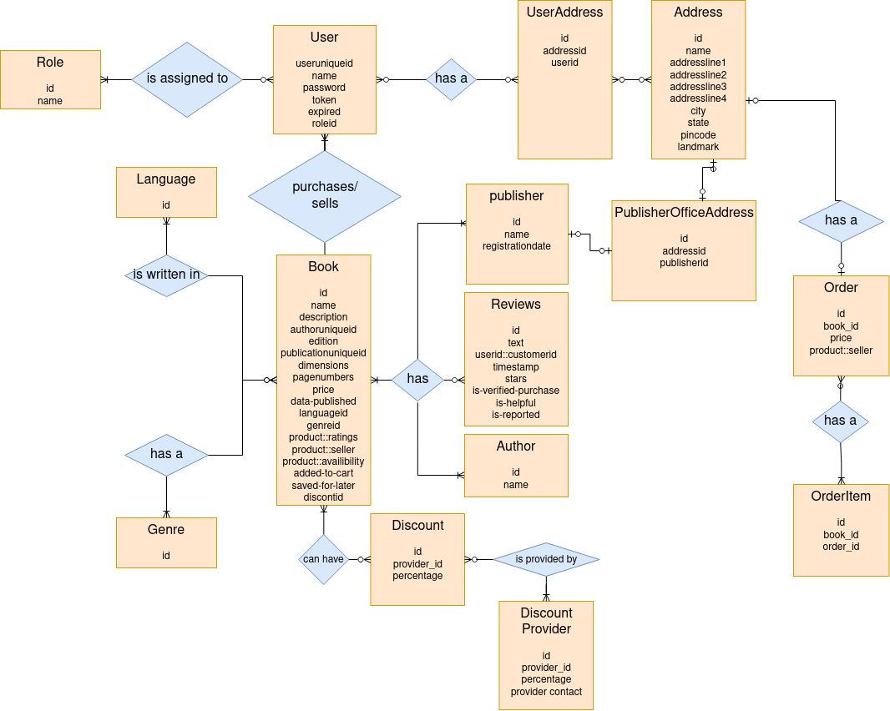
ERD

Slide 8
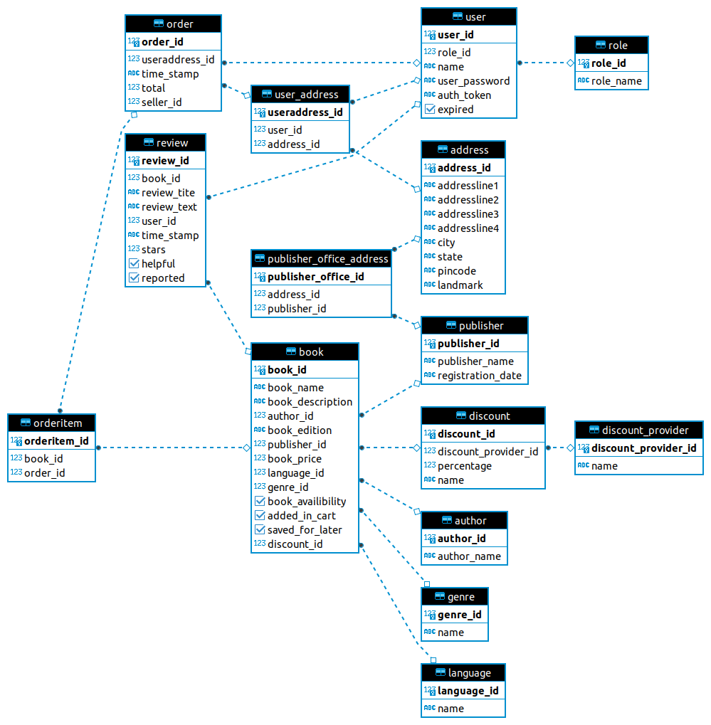
DATABASE DIAGRAM

Slide 9
Feature_API_SQL_Guide

Slide 10
CLICK HERE TO GOTO ALL ASSIGNMENT RELATED DOCUMENT
AMAZON

Slide 11
THANK YOU !

